Slide 1

Managing the App

Slide 2
Agenda
Application Structure
Sort by type vs Sort by feature
Common filesystem structure
Translations
Debugging
Chrome Debugger
Source maps
Redbox debugging
Logging
React extensions
Testing
Introduction to Jest
Test structure
Using enzyme
Jest snapshot testing
Using React storybook for isolated UI development and testing
Distribution
Bundling your app
Distributing your app

Slide 3
Application Structure

Slide 4
Sort by type
Sort by type – separate your files by logical type (good for small-medium apps)
/src
/actions
/components
/containers
/services
/images
/reducers
/styles
/utils
index.js
Notes:
There’s more to a React Component, but will get to that in a bit

Slide 5
Sort by feature
Sort by feature– separate your files by feature(ish) (good for any app)
/src
/components
/Notifications
/components
index.js
actions.js
reducer.js
notifications.css
/scenes(pages)
/Home
/components
home.css
index.js
/Products
/services
/utils
/styles
index.js
Notes:
There’s more to a React Component, but will get to that in a bit

Slide 6
Common filesystem structure
/components – folder for all components we can reuse across an application
components/hocs – here you can put your reusable higher order components
/scenes – also can be called pages or features – specific features pages or scenes in your application
/layouts – in case your web application have various layouts or theming options it’s probably good to introduce layouts directory
/services – May be called providers. Service is self contained module where you define business logic of your app. For example authService, geoLocationService etc. This logic can be reused from web to native apps
/utils – Will contain small helpful utils for reusable non application specific logic
Notes:
There’s more to a React Component, but will get to that in a bit

Slide 7
Internationalization (i18n)

Slide 8
Translations
Multi language applications will definitely have translations
i18n-react
react-i18next
i18n with webpack
Let's see examples using i18n-react
npm install --save i18n-react
Notes:
There’s more to a React Component, but will get to that in a bit

Slide 9
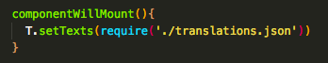
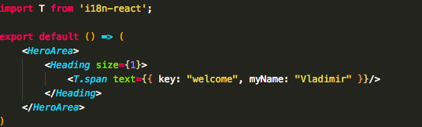
Translations
Notes:
There’s more to a React Component, but will get to that in a bit

Slide 10
Translations
setTexts – used to bring in translations.json
T.span – React component that renders span/div/a with provided text prop as an object.
<T.span text={{ key: "welcome", myName: "John" }}/>
Variables can be passed to translation json
Notes:
Translation in runtime – T.translate function
<T.a text="path.to.string" href="a's href"/>
<T.text tag='h1' text="path.to.string" context: "context-if-any"/>
<T.p text={{ key: "path.to.string", var1: "string", var2: 2}} anyValidHtmlAttribute="p.will.have.it"/>
<T.span text={{ key: "path.to.string", context: "context-if-any", var1: "string", var2: 2, var3: <span className="c">X</span>}}/>
<h1>{T.translate("path.to.string", { context: "context", val: 1})}</h1>

Slide 11
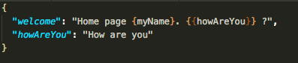

Translations
{variableName} – passing variable from T.component
{{keyName}} – referencing other keys from the same file
Notes:
There’s more to a React Component, but will get to that in a bit

Slide 12
Notes:
Add

Slide 13
Exercise
Organize your previous exercise using standard folder structure
Add multi language support to your web app
Add language switcher in App navigation navbar
Notes:
There’s more to a React Component, but will get to that in a bit

Slide 14
Debugging

Slide 15
Chrome Debugger
Elements tab– used to navigate your web page html structure
Console tab – displays logging and gives an ability to write JS inside dev tools (Console can be toggled on any tab by using ESC key)
Network tab – use to debug network requests
Performance – used for performance capturing
Memory – used for memory audit
Application – manage local storage, session storage, cookies, app cache and more
Security – display security certificates
Audit tab – new added tab with various audit options
Notes:
There’s more to a React Component, but will get to that in a bit

Slide 16
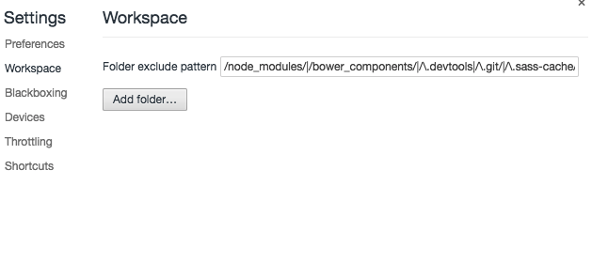
Chrome Debugger
Settings | Workspaces can map between Sources and actual files on disk
Notes:
There’s more to a React Component, but will get to that in a bit

Slide 17
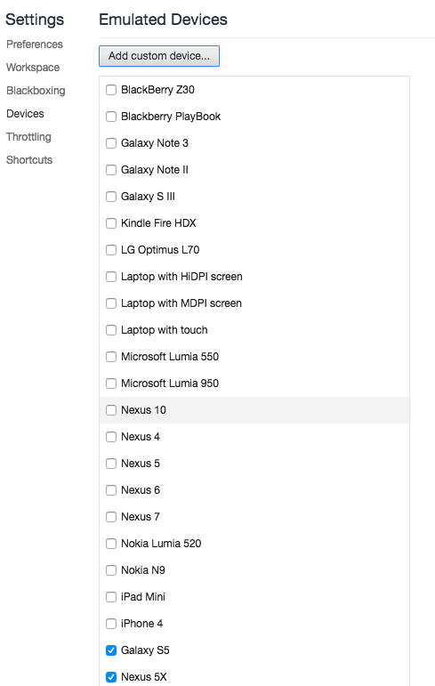
Chrome Debugger
Settings | Device gives you ability to add emulated devices for responsive web application test
Notes:
There’s more to a React Component, but will get to that in a bit

Slide 18
Chrome Debugger
Settings | Throttling gives you ability to add custom throttle profile to simulate exact network behavior
Throttling is a way to simulate network speed
Notes:
There’s more to a React Component, but will get to that in a bit

Slide 19
Source maps
Source maps are mapping files between your original code and transpiled code.
Chrome can parse this source maps and display original code inside Chrome debugging tools
Notes:
There’s more to a React Component, but will get to that in a bit

Slide 20
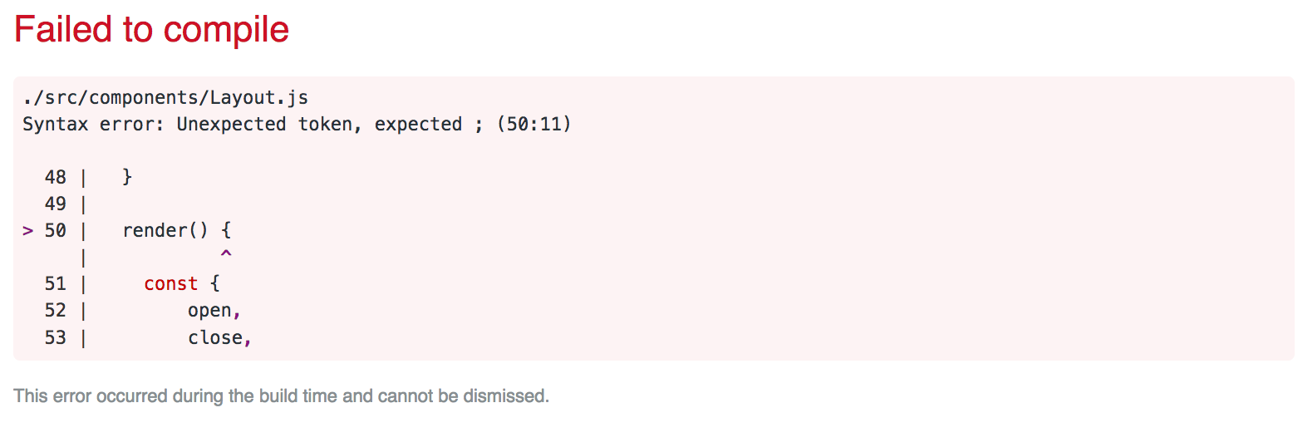
Redbox debugging
create-react-app uses Redbox debugging tool to show errors inside the browser
Notes:
There’s more to a React Component, but will get to that in a bit

Slide 21
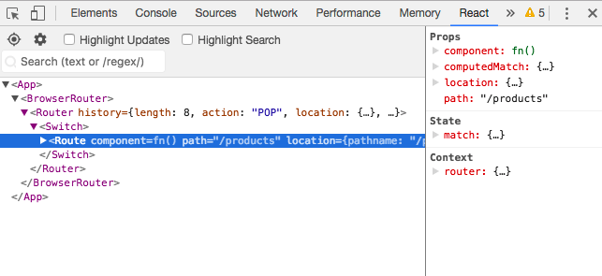
React-Devtools
Chrome extension that lets you inspect your React components
Notes:
There’s more to a React Component, but will get to that in a bit

Slide 22
Notes:
Add

Slide 23
Testing

Slide 24
Introduction to Jest
Comes by default with create-react-app
create-react-app comes with basic smoke test for App.js
Tests can run by executing npm test
Test framework from facebook with various awesome features
In case you create your app without create-react-app you can use
npm install --save-dev jest babel-jest babel-preset-es2015 babel-preset-react react-test-renderer
Notes:
There’s more to a React Component, but will get to that in a bit

Slide 25
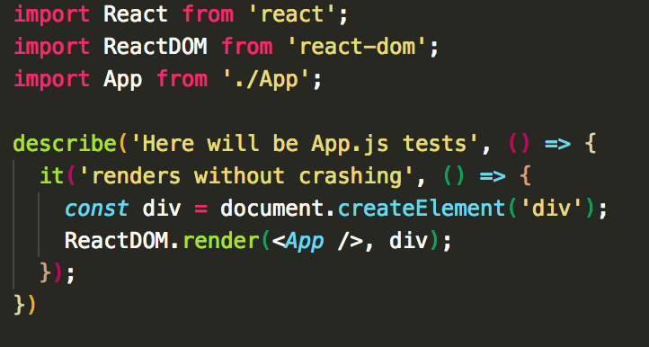
Test structure
describe – a function that wraps our test and lets us specify test description as well as running custom code before or after each test
it– single test wrapping function. Every it need to contain single test
expect – used to actually test our component
Notes:
There’s more to a React Component, but will get to that in a bit

Slide 26
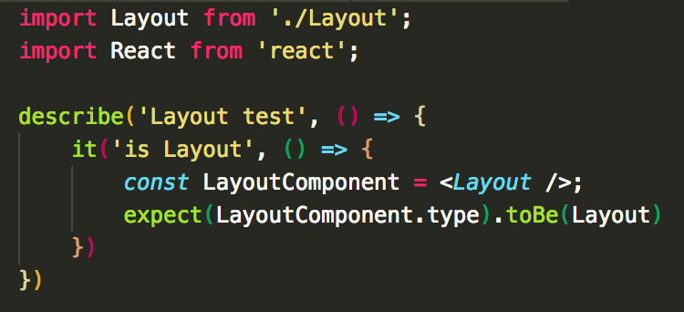
expect
expect is used for assertions and can be used with various helpers. For example:
Notes:
There’s more to a React Component, but will get to that in a bit

Slide 27
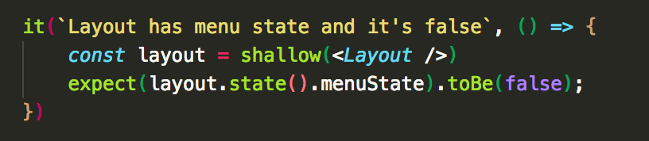
Enzyme
Test framework from Airbnb that has various useful utils for traversing React components
Enzyme provides shallow and mount utils that renders components and lets you inspect state and props
Installation:
npm i --save-dev enzyme enzyme-adapter-react-16
Notes:
There’s more to a React Component, but will get to that in a bit

Slide 28
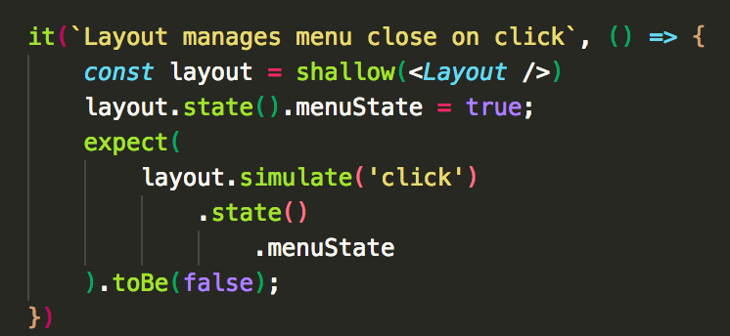
Enzyme shallow
Shallow renders one level of component and lets you inspect its state and props:
Simulate events:
Notes:
There’s more to a React Component, but will get to that in a bit

Slide 29
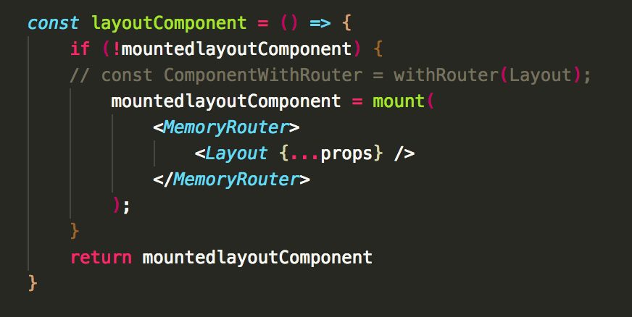
Enzyme mount
Mount actually mounts the whole tree in memory.
To mount components that use any of react-roter-dom components inside you need to wrap it in MemoryRouter
Notes:
There’s more to a React Component, but will get to that in a bit

Slide 30
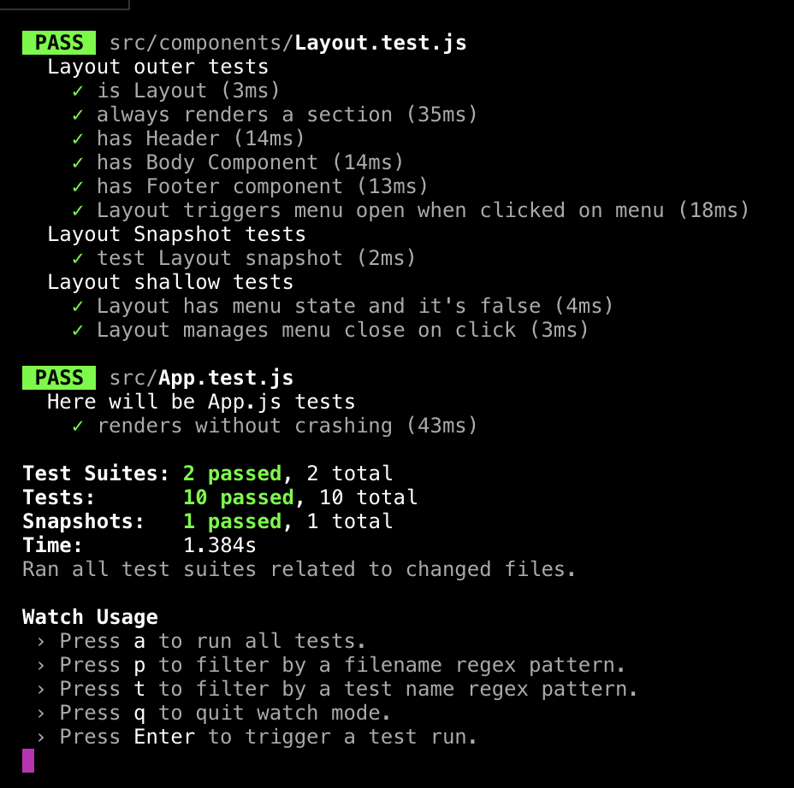
Helpful Jest cli options
--verbose
Notes:
There’s more to a React Component, but will get to that in a bit

Slide 31
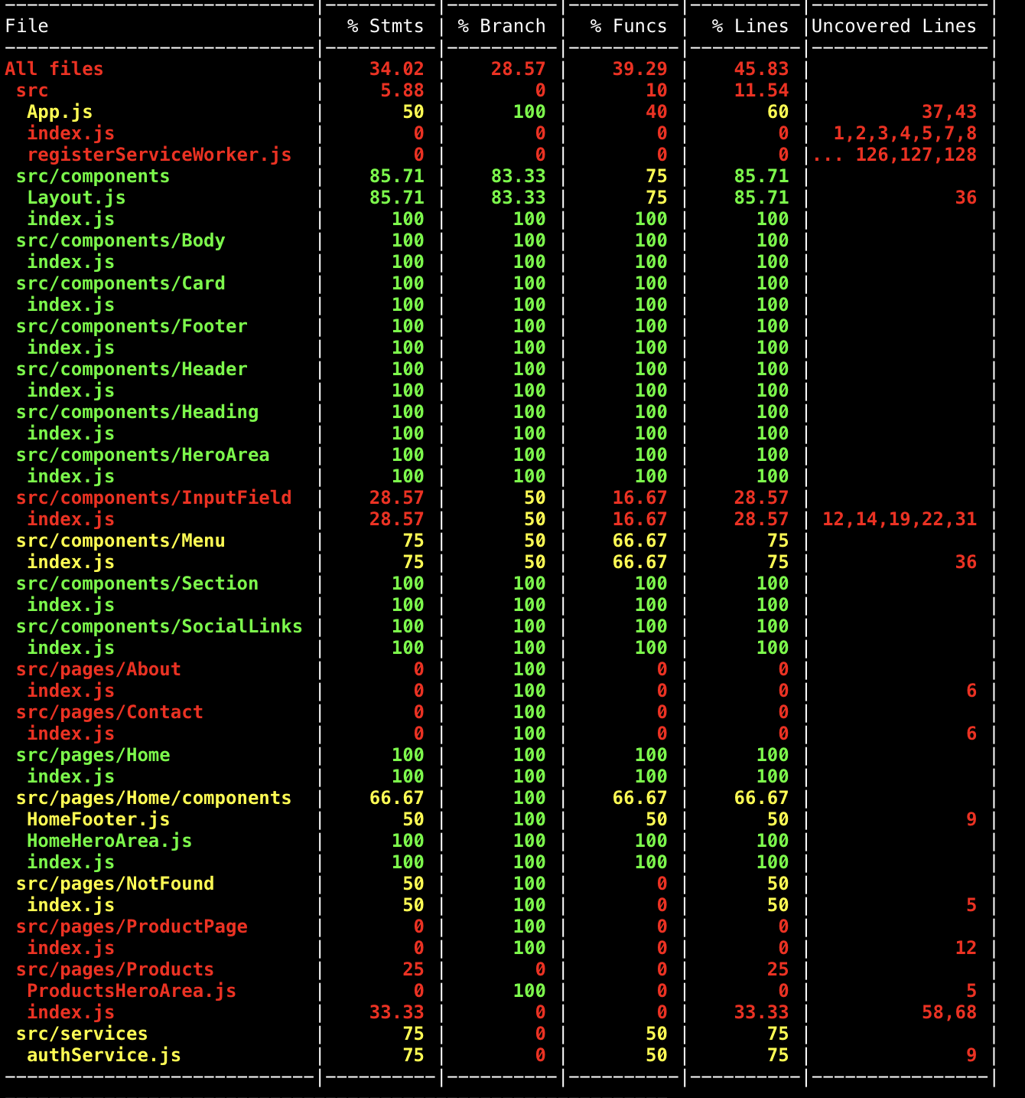
Helpful Jest cli options
--coverage – Provides command line report for code coverage
Notes:
There’s more to a React Component, but will get to that in a bit

Slide 32
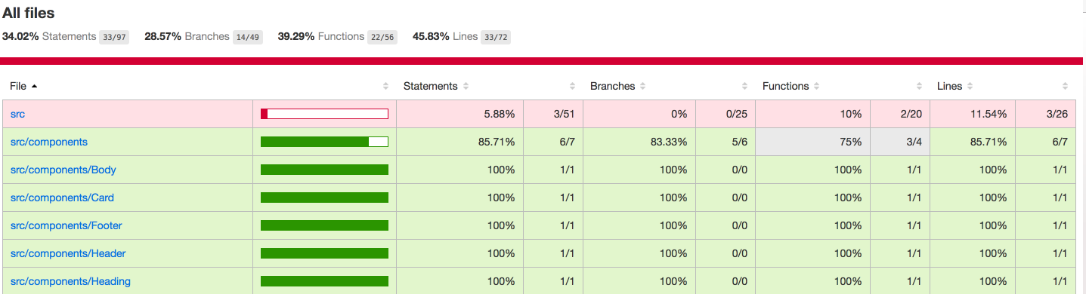
Jest code coverage
Coverage option also create a web page in coverage folder that display more details on code coverage
Notes:
There’s more to a React Component, but will get to that in a bit

Slide 33
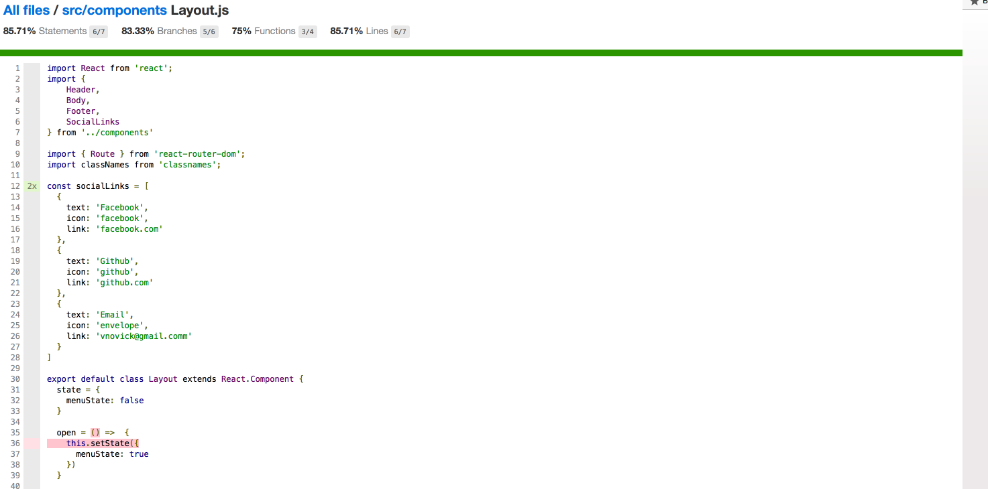
Jest code coverage
Shows actual statements that are uncovered
Notes:
There’s more to a React Component, but will get to that in a bit

Slide 34
Jest snapshot testing
Jest provides snapshot testing feature
Creates full component snapshots files
Compares it against previous ones
Indicates whether changes were made
Notes:
There’s more to a React Component, but will get to that in a bit

Slide 35
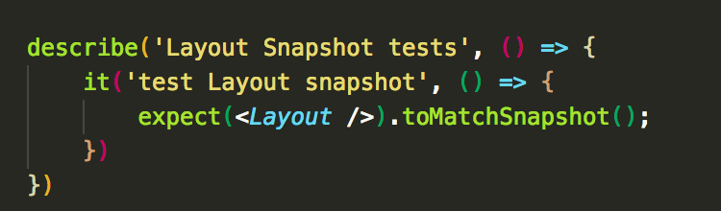
Jest snapshot testing
Jest lets you generate snapshot files to match your component with
Notes:
There’s more to a React Component, but will get to that in a bit

Slide 36
Notes:
Add

Slide 37
React storybook
Isolated react environment to develop your UI component in isolation
Pros:
Develop and test your components in API first mindset
Provide visual feedback
Dynamic style guide
Live docs
Cons.
None
https://storybook.js.org
Notes:
There’s more to a React Component, but will get to that in a bit

Slide 38
Notes:
Add

Slide 39
Exercise
Research storybook from official documentation and generate storybook for your app
Move all your components inside a storybook
Write basic tests for all your components
Notes:
There’s more to a React Component, but will get to that in a bit

Slide 40
Distribution

Slide 41
Bundling your app
npm run build with create-react-app
Rules to consider when bundling your app alone
Minify your JS & CSS
Optimize your css with postcss plugins
Be aware that sourceMaps in prod are good for debugging but allow users to see your code
Try to get rid of unused packages (use chrome dev tools code coverage tool to get rid of dead code)
Notes:
There’s more to a React Component, but will get to that in a bit

Slide 42
Distribution
Distributing your app can be done in tons of ways and mainly a topics of DevOps engineers.
Mostly depends on how your application is served
Served static files from CDN
Use frontend web servers to serve assets
NGINX, Apache, IIS, Service Fabric, Node
Notes:
There’s more to a React Component, but will get to that in a bit

